Slide 1
Real-world Anomaly Detection in Surveillance Videos
Waqas Sultani , Chen Chen, Mubarak Shah CVPR 2018

Slide 2
Motivation
- Surveillance cameras are increasingly being used in public places
- The monitoring capability of law enforcement agencies has not kept pace
- Develop intelligent algorithms for automatic video anomaly detection to alleviate the
Waste of labor and time

Slide 3
Contribution
- We propose a MIL solution to anomaly detection by leveraging only weakly labeled
Training videos.
- We introduce a large-scale video anomaly detection dataset consisting of 1900 real-
world surveillance videos of 13 different anomalous events and normal activities
captured by surveillance cameras.
Our dataset also serves a challenging benchmark for activity recognition on untrimmed
videos, due to the complexity of activities and large intra-class variations.

Slide 4
Limitations of Previous Approaches
Detect a specific anomalous event, e.g. traffic accident
- Generalization issue
Sparse-coding based approaches
- Assume the initial portion of a video contains normal events for building the
normal event dictionary
- Do not handle environmental change well

Slide 5
Our Approach
Goal – identify the time window of the anomaly in a long surveillance video

Slide 6
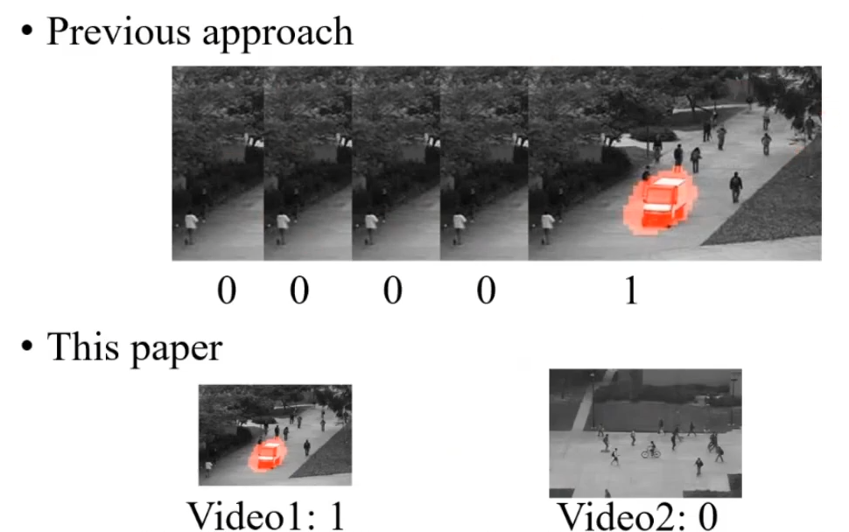
Our Approach
Using weakly labeled training videos
clip-level이 아니라, video-level에서 라벨링

Slide 7
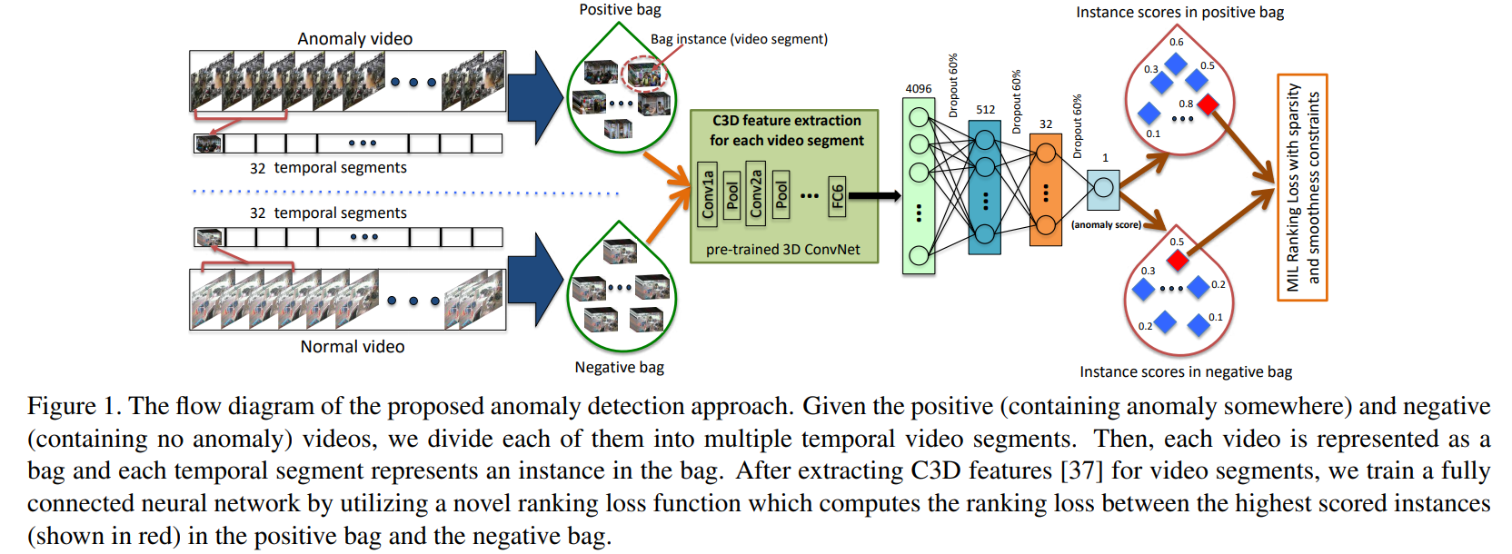
Our Approach

Slide 8
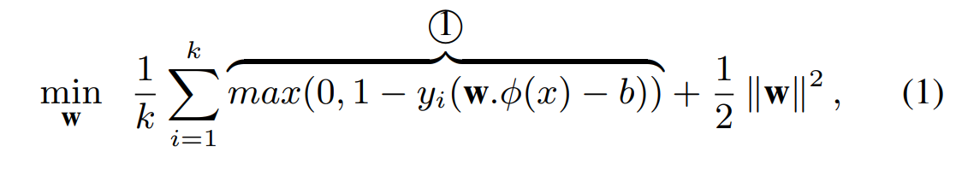

Multiple Instance Learning
In standard supervised classification problems using support vector machine, the labels of all positive and negative examples are available and the classifier is learned using the following optimization function:

Slide 9
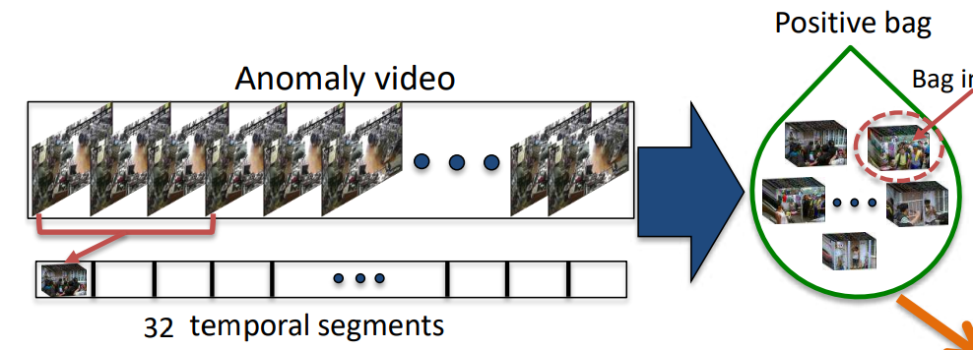
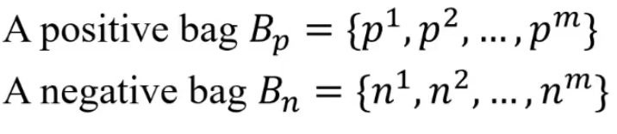
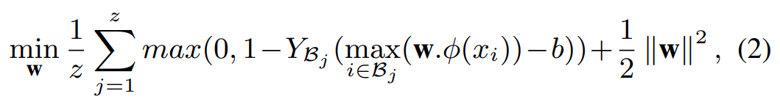
Multiple Instance Learning

Slide 10
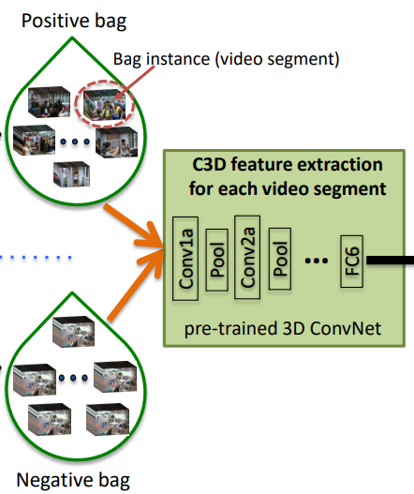
C3D feature

Slide 11
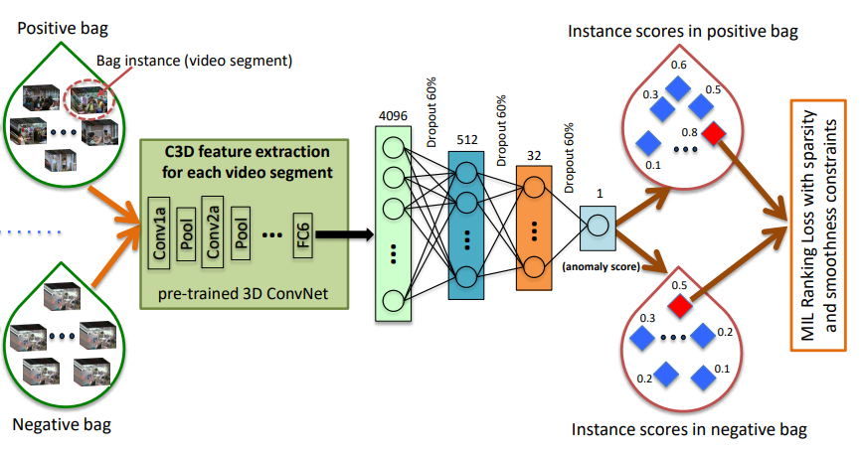

Slide 12


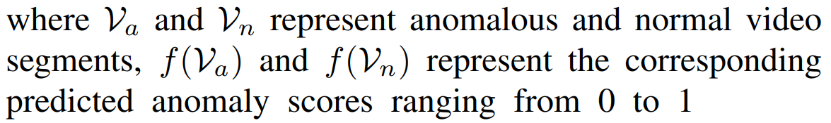
Deep MIL Ranking Model

Slide 13
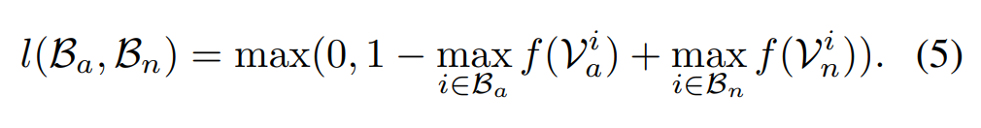
Ranking loss
One limitation is that it ignores the underlying temporal structure of the anomalous video.

Slide 14
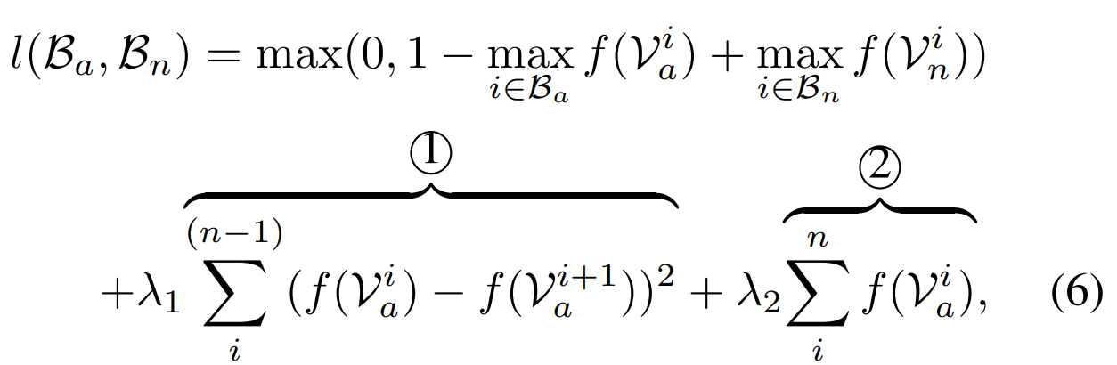
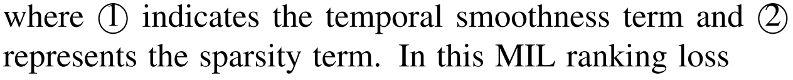
Ranking loss

Slide 15
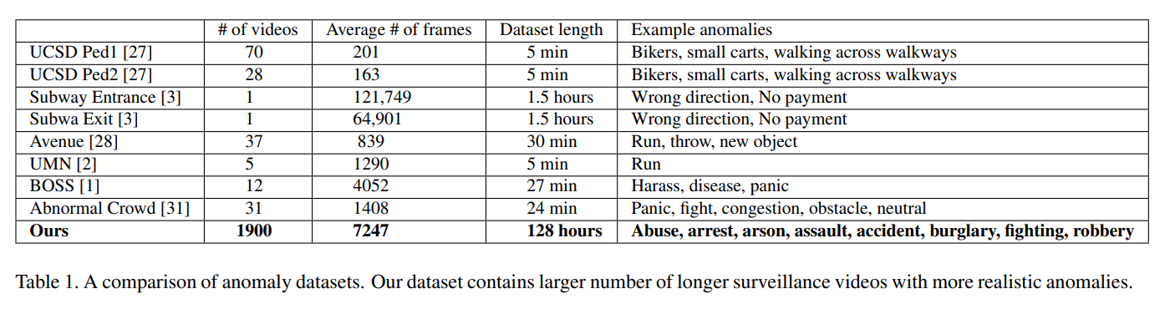

Slide 16
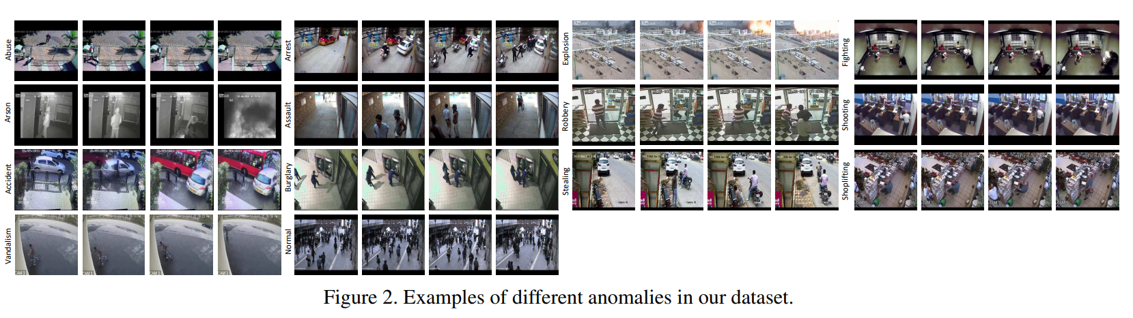

Slide 17
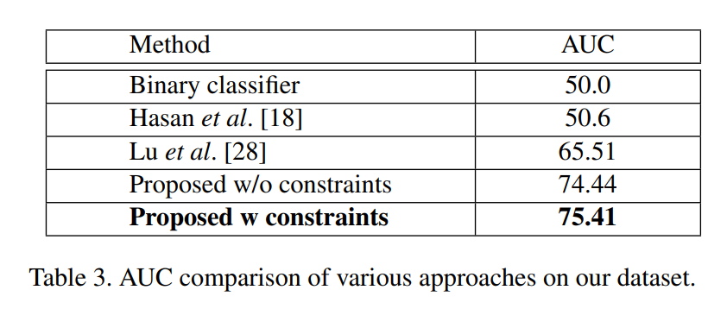

Slide 18
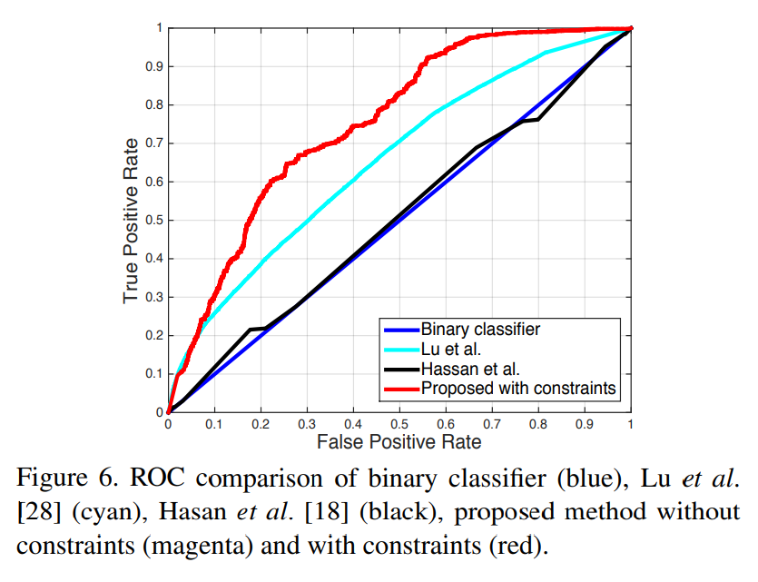

Slide 19
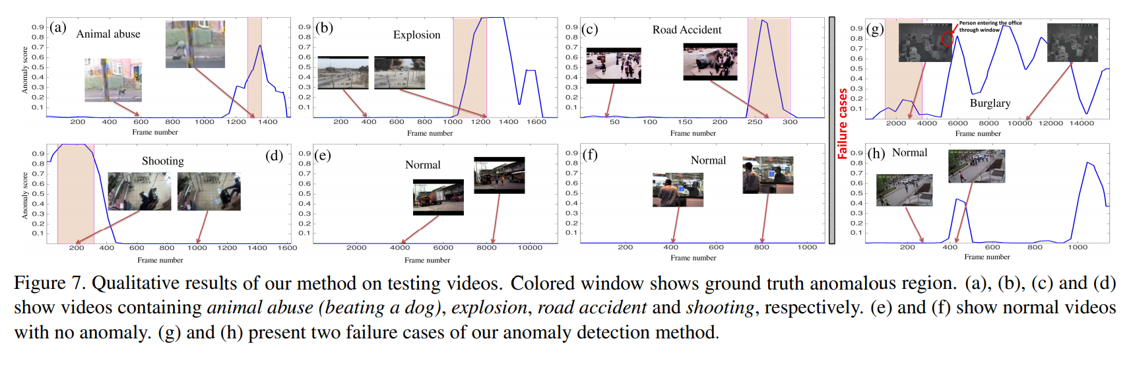

Slide 20
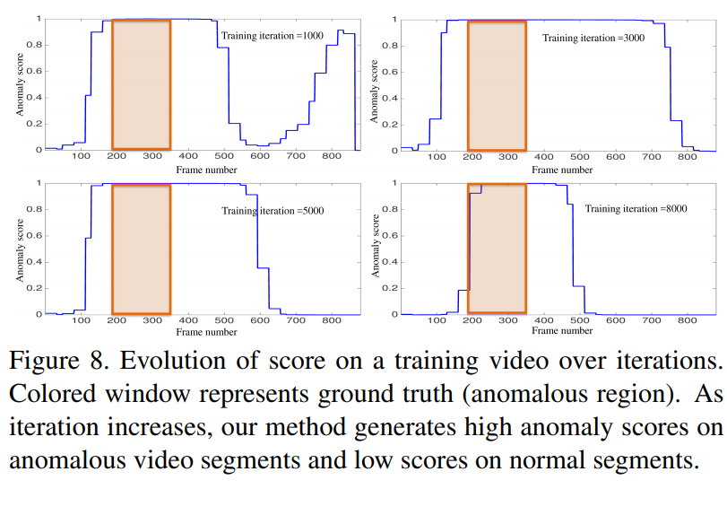

Slide 21
감사합니다.

